Slide 1
Code forces
B. Ilya and Queries

Slide 2
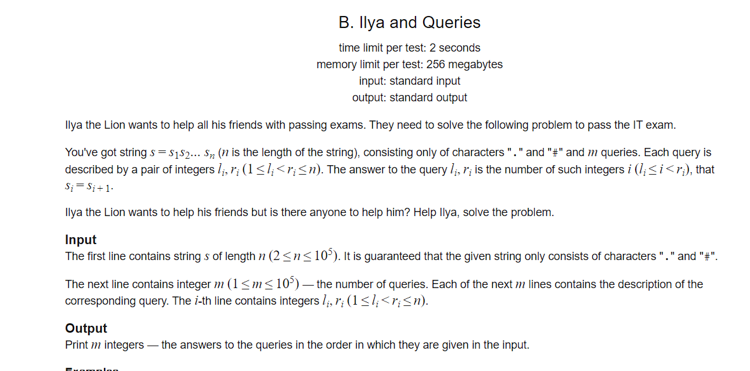

Slide 3
First approach :brute force
Given L and R are we finiiterate through the range count the valid range
for i in range(l,r):
count=0
if s[i]==s[i+1]:
count+=1
Print(count)

Slide 4
But it coast 0(n) for every query

Slide 5
Oitimazed approach
Counting every valid items in up to that index
Example
Presum=[1]
‘ [....###....#]
Presum =[1,2,3,4,4,5,6,6,7,8,9,9]
so when ever we asked how many valid intgers are there in the array we fined the difference between the indexes
If l=1 and r=4
the valid items would be 4-1=3 those are s[0] , s[1] and s[2]

Slide 6
implementation

